Slide 1

Square Application Usage Guide
Triage Team SQUARE LOG IN ID = JENPARK@HSNFE.COM PW = SSHSN07072

Slide 2

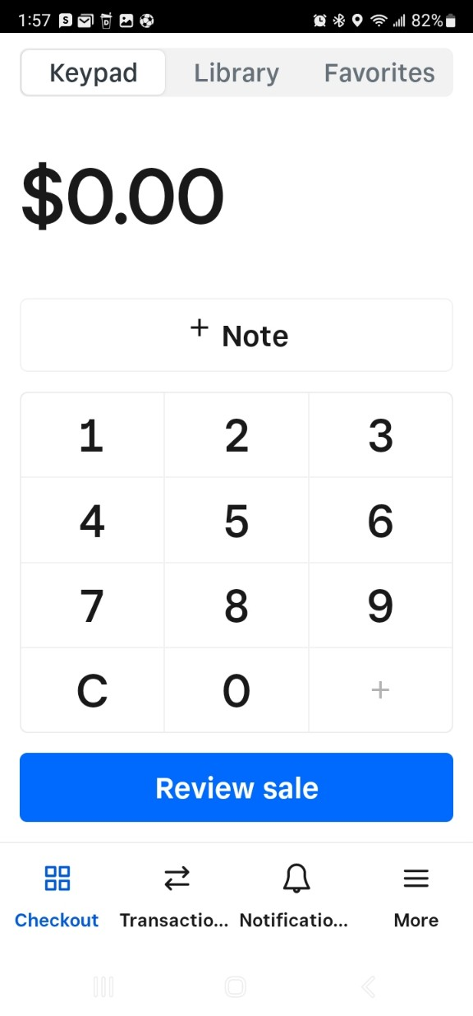
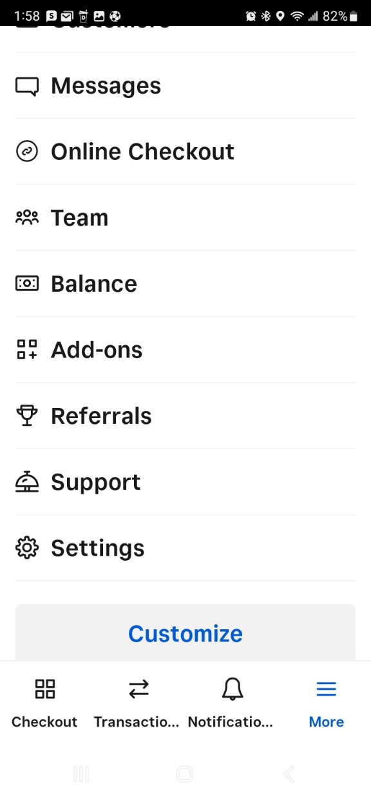
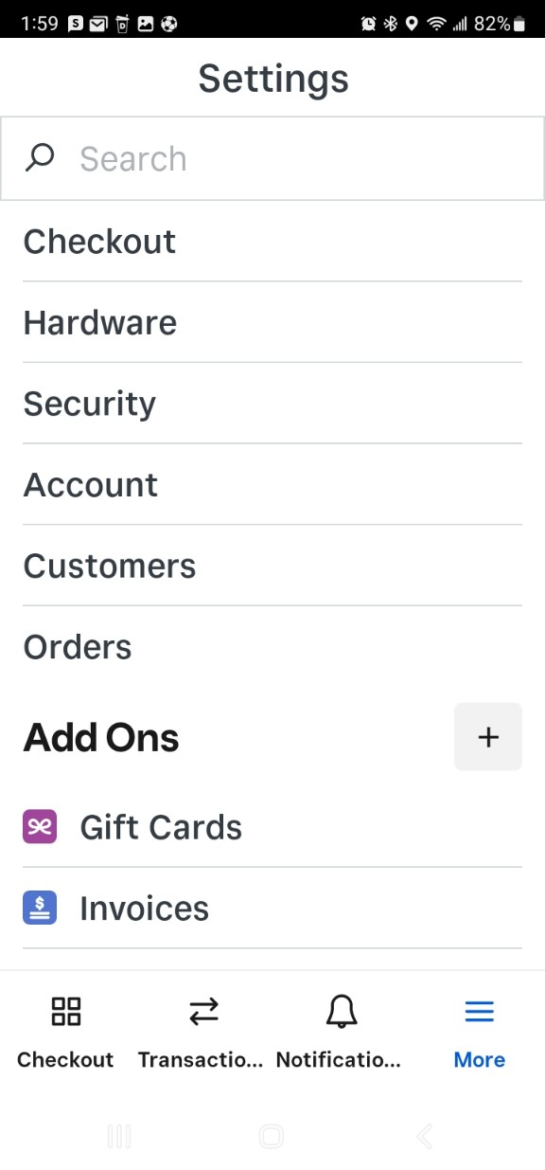


1. Touch “More”
1. Insert Device Name
2. Touch “Settings”
3. Touch “Hardware”

Slide 3
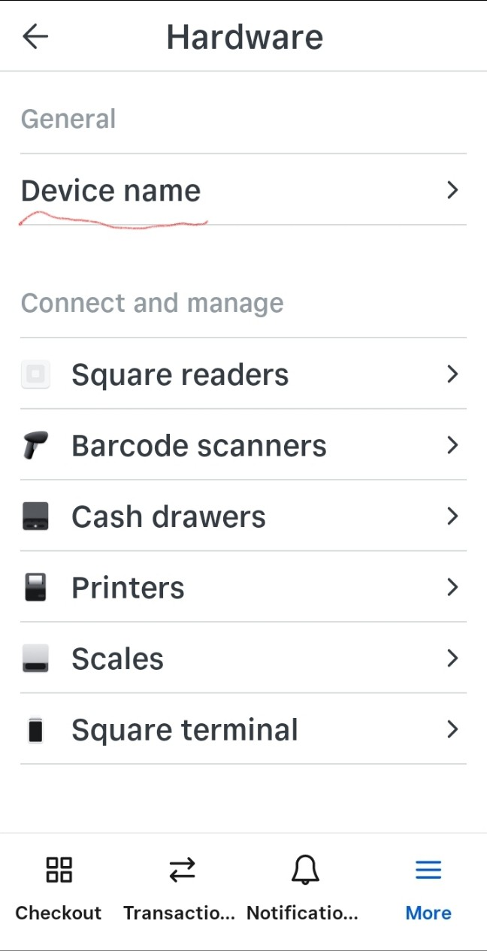
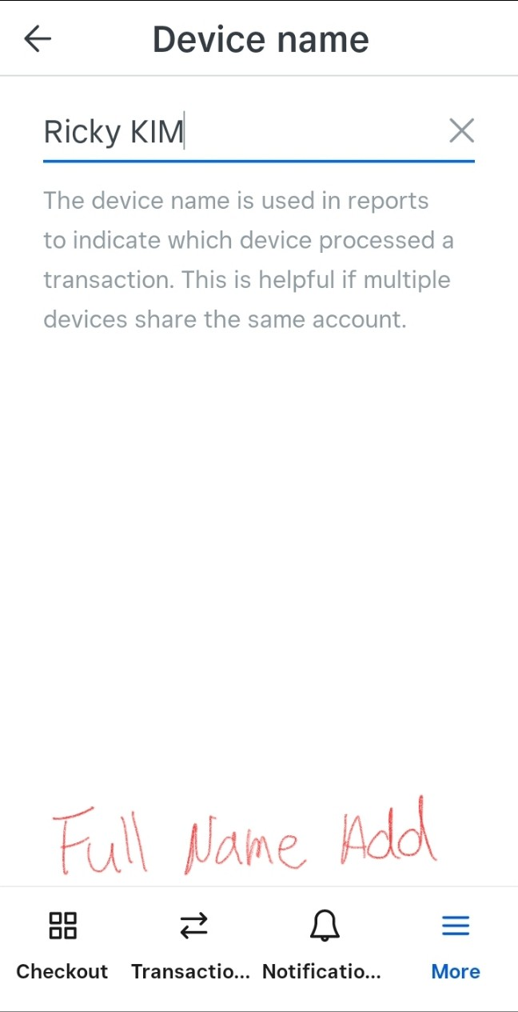

4. Touch “Device name”
1. Insert Device Name
5. Insert full name
Need to insert
“Your full name”

Slide 4
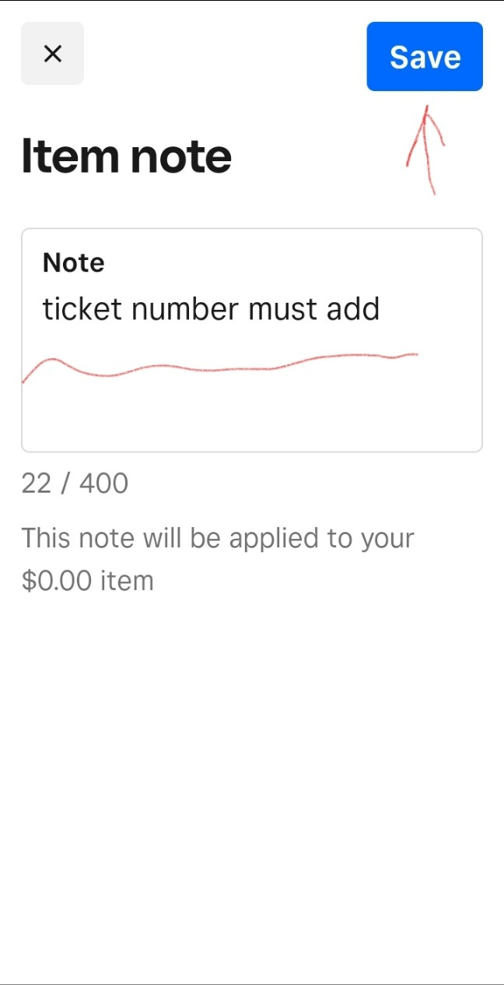
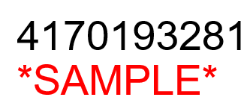
1. Touch “Note”
2. Insert Ticket #
2. Insert Ticket #
Need to insert
“Ticket Number”

Slide 5

1. Go to Square App
3. Initialize Tax Settings
2. Touch “More”
Scroll down and
touch “Settings”

Slide 6
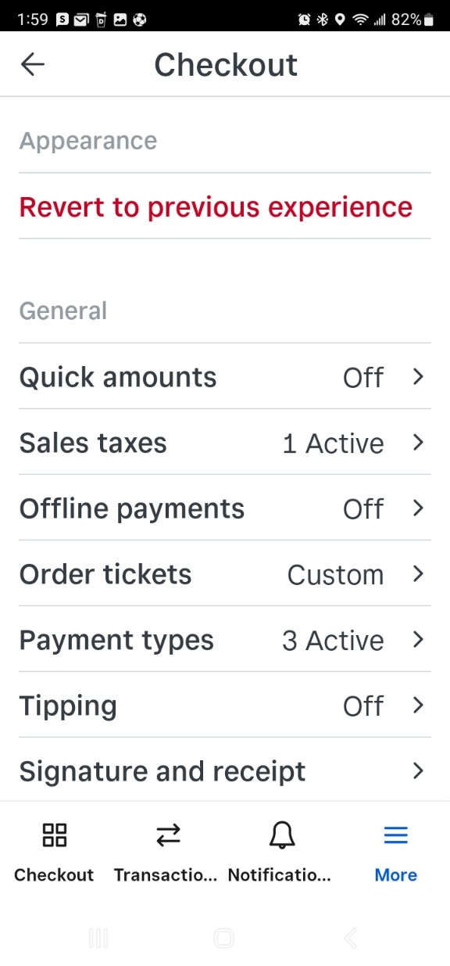
5. Check “Sales taxes” section
3. Initialize Tax Settings
4. Touch “Checkout”
If any sales taxes section is “Active” will manually calculate or amount plus tax !

Slide 7
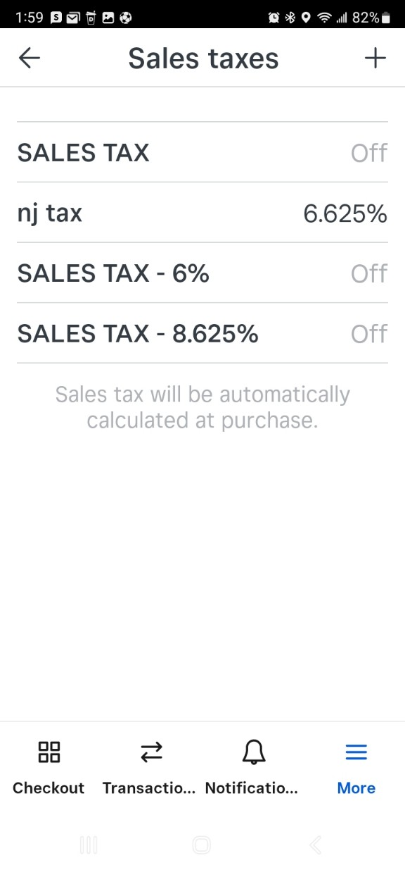
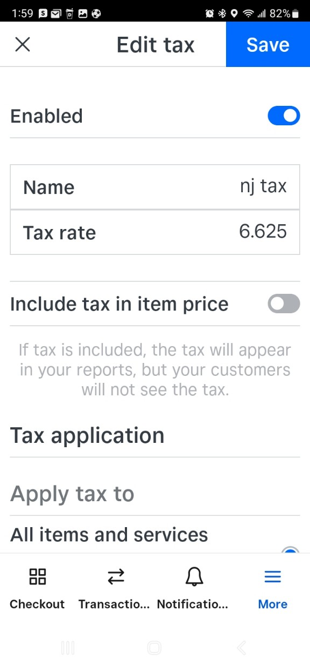


7. Turn off activated tax
3. Initialize Tax Settings
6. Touch activated sales tax
Touch “Enabled”
section bar and turn off.
2. Save it !

Slide 8


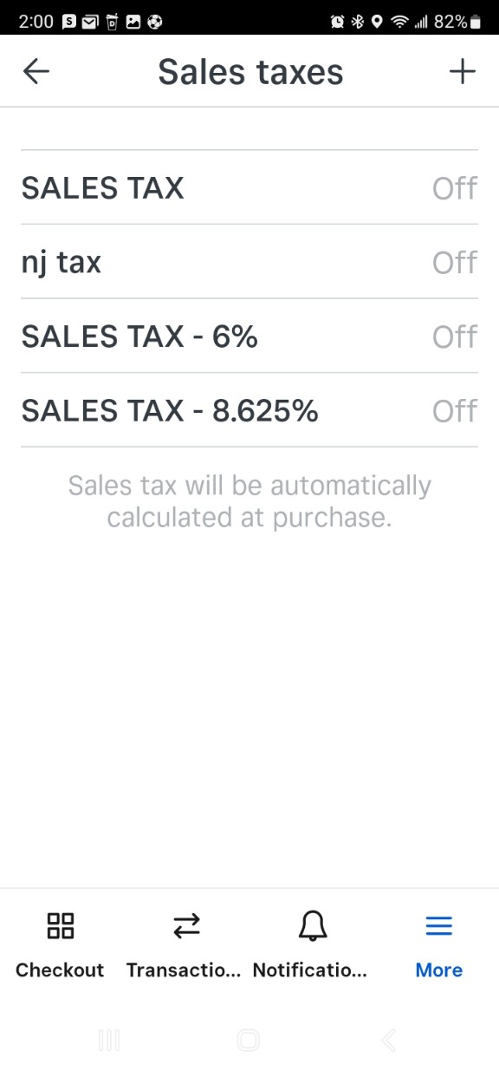
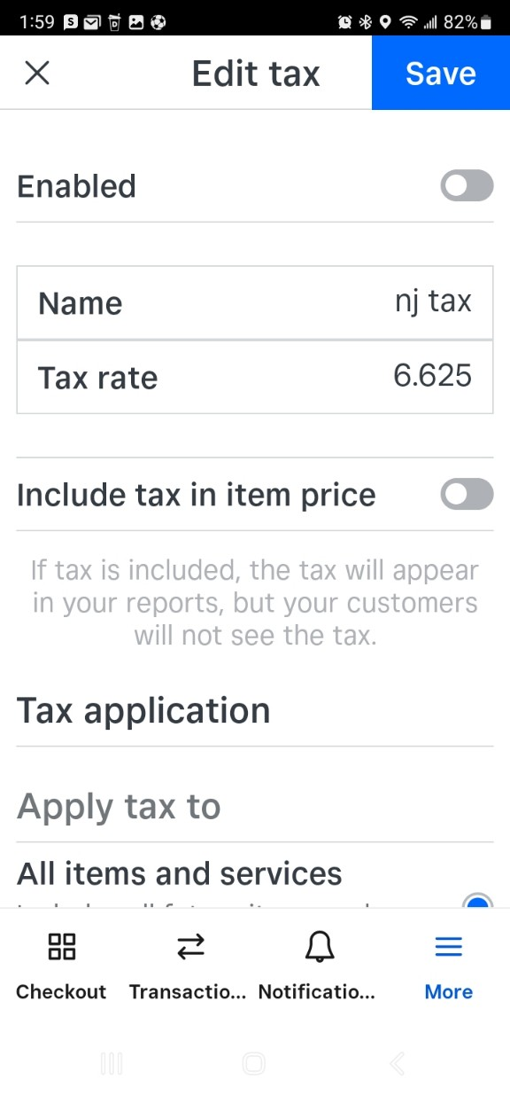

8. Check whether the tax status is “off”
3. Initialize Tax Settings
All Sales tax should be off !
Good to go now !

Slide 9
Television Service Fees & Home Appliance Rate
TV / Monitor (HE) Service Fees
<Tax rate per region>
Size | Regular(Trip+Labor) | Panel(Trip+Labor)
Up to 49" | $ 190.00 (T120+L70) | $ 215.00 (T120+L95)
50-65" * | $ 210.00 (T120+L90) | $ 250.00 (T120+L130)
66-79" * | $ 260.00 (T120+L140) | $ 295.00 (T120+L175)
80" & up* | $ 380.00 (T120+L220) | $ 620.00 (T120+L500)
Region | Rate | etc
MA | 6.25% | Parts only
CT | 6.35% | -
NJ | 6.625% | -
PA | 6.00% | -
VT/MD/VA | 6.00% | Parts only
NYC | 8.625% | -
NYR | 8.00% | -
FLO | 6.00%
RI | 7.00%
Home appliance (HA) Service Fees
HA
HOME APPLIANCE FLAT LABOR RATE: |  | $120 Initial Trip / Diagnostic + $95 Labor => $215
MAJOR DRUM FLAT RATE: | $380 (Includes extra man, take over 2 hours) | ONLY APPLICABLE FOR WASHERS [INCLUDES EXTRA MAN, > 2 HRS] / FLEX WASHER
OTHER APPLICABLE EXTENSIVE LABOR RATE: | $320 (2 HRS LABOR) | ICE BUILD-UP: TECHS PLEASE ADVISE CX TO MELT ICE PRIOR ARRIVAL
 |  | DISHWASHER: SUMP REPLACEMENT
 |  | GAS OVEN: GAS / SAFETY VALVE
 |  | REFRIGERATOR: LEFT DOOR [ALONE IS 1 HR] + ADD 'L DOORS
SSR RATE: | $120 Trip Fee + $1320 (350Labor+970 Parts) + Applicable taxes | $120 Trip Fee + $350 Labor (Non-refundable, even if unrepairable) + $970 Parts (If the compressor is covered under warranty, $160 will be refunded if unused. Used/broken parts are non-refundable.) + Applicable taxes

Slide 10
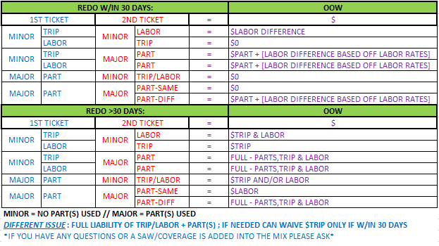
HSN Quick Reference
Home Appliance Service Fees - Trip ($120) + Labor ($95) + Part(s) + Tax
Washer Drum Labor - $380 [Includes extra man, take over 2 hours]
OTHER POSSIBLE EXTENSIVE REPAIRS @ $320 Labor [2HRS]:
REFRIGERATORS - Addt’l doors to LEFT DOOR or Ice Build-up
DISHWASHERS - Sump Repair
GAS OVEN - Gas/Safety Valve Repair
Notes on Ticket
Confirmed Date & Time
Issue with unit/symptoms
TV: Dismounted
MW – Dismounted
WM/Dryer – Unstacked
Special Instructions
Specific number to call w/description
ie: please call wife Mary@201-555-5555
Ie: new construction, corner of Main/Park
Rescheduled Tix: Add ALL Notes + new date
Need to confirm
Warranty Status + Service Type
Model and Serial Number
Customer Name and Address
Bill of Sale (and confirmation)
SAW: LP/P(part)/L(labor)/Diagnostic
SSR
5 Year Warranty, from manuf. Date or from purchase date if BOS provided.
OOW
Total Cost: $1320.00 + applicable taxes ($120 Trip Fee Paid Already),
• $350 Labor (Non-refundable, even if unrepairable)
• $970 Parts (If the compressor is covered under warranty, $160 will be refunded if unused. Used/broken parts are non-refundable.)
No warranty
Revisit by Tech
Advise Cx that you need to come back, explain why and ask Cx when (as early as possible Date/Time) is good time to come back (this will be final and Schedulers won’t call Cx).
Dryer
DVE, Electrical, advise cx to un-stack if possible.
DVG, send a tech first, w/o ask cx to un-stack them.
TV/Monitor Service Fees
Trip ($120) + Labor + Parts + Tax
Includes extra man, special truck
Size | Regular | Panel
Up to 49” | $190 | $215
50-65” | $210 | $250
66-79” * | $260 | $295
80” & up* | $380 | $620
50% Deposits Requirements:
OOW TV Panels
Physical Damages

Slide 11
